Slide 1
Introduction to
Cyclomatic Complexity

Slide 2
Cyclomatic Complexity
It was developed by Thomas J. McCabe in 1976 and is used to indicate the complexity of a program.
CC or Complexity (M)=E-N+2P
  where
  E = the number of edges of the graph
  N = the number of nodes of the graph
  P = the number of exit
OOSE-Chapter 11 Testing

Slide 3
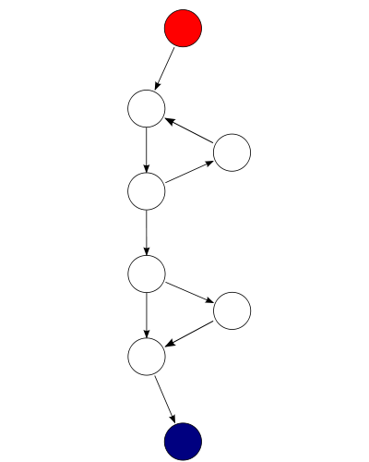
For this graph, E = 9, N = 8 and P = 1, so the cyclomatic complexity of the program is 9 - 8 +(2*1) = 3.
OOSE-Chapter 11 Testing

Slide 4

The same function as above, shown as a strongly connected control flow graph. For this graph, E = 10, N = 8 and P = 1, so the cyclomatic complexity of the program is 10 - 8 + 1 = 3.
OOSE-Chapter 11 Testing

Slide 5
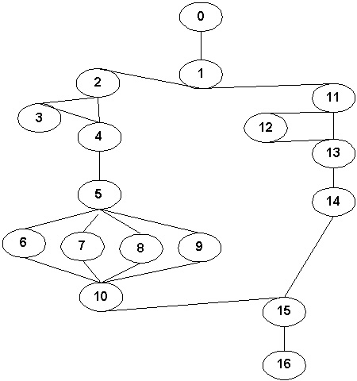
OOSE-Chapter 11 Testing

Slide 6
The answer is:
CC=7 (22E-17N+2P)
OOSE-Chapter 11 Testing

Slide 7
Cyclomatic Complexity
Other considerations:
Start with 1. There is at least one path through the method.
Add 1 for each conditional statement or looping statement. (So, add 1 for “if”, “while”, “foreach”)
Add 1 for each AND or OR logical operator used in a condition.
Add 1 for each case or switch statement.
Add 1 for each catch statement.
OOSE-Chapter 11 Testing

Slide 8
Example 1
public void isValidSearchCriteria(SearchCriteria s){
if(s!=null) {
return true;
}else{
return false;
}
}
OOSE-Chapter 11 Testing

Slide 9
The answer is:
CC=1+1=2 (one if +1)
OOSE-Chapter 11 Testing

Slide 10
Example 2
public WaitableThread(ThreadStart start) {
this.start = start;
this.signal = new ManualResetEvent(false); this.SafeWaitHandle = signal.SafeWaitHandle; this.thread = new Thread(new ThreadStart(ExecuteDelegate));
}
OOSE-Chapter 11 Testing

Slide 11
The answer is:
CC=1 (No conditionals, loops, or anything else of interest.)
OOSE-Chapter 11 Testing

Slide 12
Example 3
foreach (LockFreeQueue q in queueList) {
if (q.Dequeue(out item)) {
return true;
}
}
item = default(T);
return false; }
}
OOSE-Chapter 11 Testing

Slide 13
The answer is:
CC=3 (Count 1 for the main path, 1 for the foreach, and 1 for the if.)
OOSE-Chapter 11 Testing

Slide 14
Example 4
public void findApplications(String id, String name){
if(id!=null && name!=null) {
//do something
}else{
//do something
}
}
OOSE-Chapter 11 Testing

Slide 15
The answer is:
CC=3 (Count 1 for the main path, 1 for the normal if-else decision points and one for the logical AND operation.)
OOSE-Chapter 11 Testing

Slide 16
Example 5
if A=354
then if B>C
then A=B
else A=C
endif
endif
print A
OOSE-Chapter 11 Testing

Slide 17
The answer is:
CC=3 (There are two decision points)
OOSE-Chapter 11 Testing

Slide 18
Example 6
int i, int j {
if ( i>0 && j>0 ) {
while ( i>j ) {
if ( i% 2 && j % 2)
print( "%d\ n", i );
else
print ("%d\ n", j );
i--;
}
}
}
OOSE-Chapter 11 Testing

Slide 19
The answer is:
CC=6 (Starting with 1, two "if" statements, one "while" statement,and two "&&" operators.)
OOSE-Chapter 11 Testing

Slide 20
Example 7
int i {
if (n>o) {
switch(n) {
case 0: case1: printf("zero or one\n");
break;
case2: printf("two\n");
break;
case3: case4: printf("three or four\n");
break;
}
} else
printf ("negative\n");
}
OOSE-Chapter 11 Testing

Slide 21
The answer is:
CC=5 (Starting with 1, one "if" statement, the switch statement has three "case-labeled statements".)
OOSE-Chapter 11 Testing

Slide 22
Cyclomatic Complexity | Risk Evaluation
1-10 | a simple program, without much risk
11-20 | more complex, moderate risk
21-50 | complex, high risk program
greater than 50 | untestable program (very high risk)
OOSE-Chapter 11 Testing

